Slide 1
Medicare, Buy-In Program and Dual Eligibles

Slide 2
Medicare

Slide 3
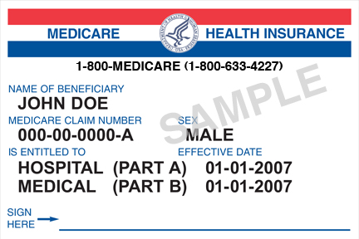
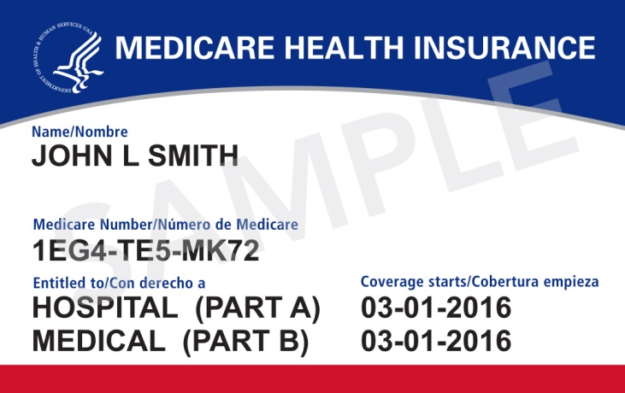
The Basics
Administered by:
Eligibility: the Social Security Administration (SSA)
Coverage: Center for Medicare and Medicaid Services (CMS)
Three Parts (Parts A, B, D – Part C is not really a part)
The “Red, White and Blue” card (New Cards Being Issued Now)

Slide 4
Eligibility
Age 65, with enough work quarters
or:
On Social Security Disability (SSD)
NOTE – Coverage starts 24 months after eligibility for Social Security checks (don’t forget 5 month waiting period for checks)
Exceptions ESRD; Lou Gehrig’s disease

Slide 5
Medicare Part A: Hospital Insurance
Covers:
Inpatient hospital
Skilled nursing facility
Home health services
Hospice care
Cost-Sharing (2022):
Premium: most beneficiaries have none
People with less than 40 “quarters”, pay $252 or $499
Deductible: $1,556
Co-pays and Co-insurance: Complicated. First 60 days, $0 copay. Longer the stay, the higher the copay.
Part A
Deductible
Medicare Pays
Co-insurance

Slide 6
Medicare Part B: Medical Insurance
Covers:
Medically necessary services and supplies
For example: lab tests, doctor visits, surgeries, wheelchairs, walkers
Preventative services
Outpatient prescription drugs (like chemotherapy) and some prescription drugs delivered through injection or durable medical equipment.
Cost-Sharing:
Premium - $170.10 (2022)
Deductible - $22 (2022)
Co-insurance – 20% (for most services)
Part B
Deductible
Medicare Pays
Premiums
Co-Insurance

Slide 7
Medicare Part D: Prescription Drugs
Prescription Drug Benefits
Began January 1, 2006
Must pick a plan from a private insurance company during yearly open enrollment period
Has premiums, deductibles, copays, and coinsurance -- important to pick the right plan!
Assistance for low-income individuals
Part D
Deductible
Medicare Pays
Co-Pays
MC
Pays
Co-Insurance
Premiums
Medicare Pays

Slide 8
Part D Extra Help a/k/a Low Income Subsidy (LIS)
Administered by SSA
Covers premiums, copays, coinsurance and deductibles for Part D (not parts A or B)
Auto-enrolled in full subsidy if on any type of Medical Assistance
Otherwise apply at SSA
Amount of subsidy depends upon income
Full below 135%
Partial 135% - 150%
Asset Limit: Full: Single: $8,400; Couple: $12,600
Partial: single $14,010; couple $27,950
(plus up to $1,500 burial set aside per person)

Slide 9
100% Low Income Subsidy for Part D a.k.a. Extra Help
Part D
Part D
Deductible
Medicare Pays
Medicare Pays
Co-Pays
Copay usually:
$1.25 generic
$3.70 brand
(If have income over 100%, then
$3.35 generic
$8.35 brand)
MC
Pays
Co-Insurance
Premiums
Co-Pays
Medicare Pays

Slide 10
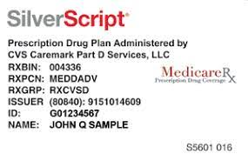
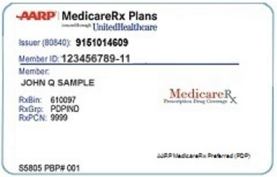
Medicare Part D
Two types of Part D plans:
1. Stand Alone Prescription Drug Plan (PDP)

Slide 11
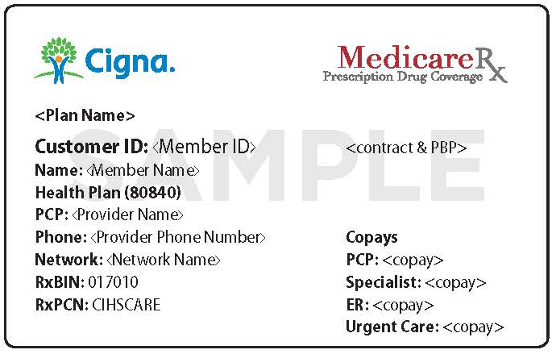
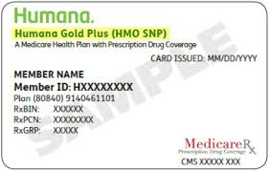
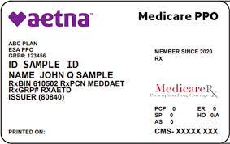
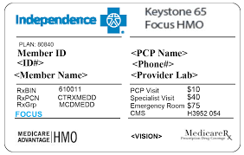
Part C (Medicare Advantage)
Medicare Advantage Plan with Prescription Coverage . . . Which brings us to Part C.

Slide 12
Medicare Part C (Medicare Advantage)
Not really a part, but a compilation of A, B, & D
Managed Care for Medicare Beneficiaries
Combined Medicare coverage and prescription drug coverage
“Special” Plans for full DUAL ELIGIBLES
(Medicare and Medicaid) a/k/a
“SPECIAL NEEDS PLANS”
Why would you enroll in a Medicare Managed Care Plan?

Slide 13
Part C (Medicare Advantage)
Medicare Advantage Plan with Prescription Coverage . . . Which brings us to Part C.

Slide 14
Medicare Enrollment Limitations
If a person does not enroll in Part A or B or D when first eligible, they may face penalties, delays, and increased premiums.
Part A/B Enrollment:
Initial Enrollment Period: 3 months before and 3 months after turn 65, or automatic after 24 months of SSD
General Enrollment: January – March, coverage starting July
Part D Enrollment:
Open Enrollment: October 15 – December 7; changes take effect Jan. 1
Medicare Advantage Enrollment (Part C):
Open Enrollment: October 15 – December 7; changes take effect Jan. 1
Disenrollment to original Medicare: January 1 to February 14.

Slide 15
Medicare and Medicaid: * Buy-in Program *Dual Eligibles

Slide 16
Help for Medicare Beneficiaries: Buy-In
Although Medicare is a Social Security Administration benefit, Pennsylvania’s Department of Human Services has several programs to cover Medicare costs:
Premiums
Co-pays
Deductibles
The programs are generally called Buy-in (also called Medicare Savings Program– MSP)
QMB
SLMB
QI

Slide 17
Qualified Medicare Beneficiary QMB
100% Federal Poverty Income Level
(2022 - $1,133 for 1 person; $1,526 for couple)
SSI Counting Rules
2022 Asset limits:
$8,400 - single
$12,600 - couple
(plus up to $1,500 burial set aside)

Slide 18
What does QMB cover?
Deductibles
Premiums
Co-pays
NOTE : Even if provider does not accept Medicaid!!!
Automatic eligibility for full Part D low-income subsidy

Slide 19
QMB and/or Health Horizons
Part A
Part D
Part B
Part D
Deductible
Deductible
Deductible
Deductible
Medicare Pays
Deductible
Deductible
Medicare Pays
Medicare Pays
Medicare Pays
Co-Pays
MC
Pays
Co-Insurance
Co-insurance
Co-insurance
Premiums
Premiums
Premiums
Co-Insurance
Co-Pays
Co-Insurance
Medicare Pays
SSA’s
Low Income Subsidy

Slide 20
Specified Low Income Medicare Beneficiary SLMB
120% Federal Poverty Income Level
(2022 - $1,359 for 1 person; $1,831 for couple)
SSI Counting Rules
2022 Asset limits:
$8,400 - single
$12,600 - couple
(plus up to $1,500 burial set aside)

Slide 21
What does SLMB Cover?
Premiums
Automatic eligibility for full Part D low-income subsidy
Part A
Part D
Part B
Part D
Deductible
Deductible
Deductible
Medicare Pays
Deductible
Medicare Pays
Medicare Pays
Medicare Pays
Co-Pays
MC
Pays
Co-Insurance
Co-insurance
Premiums
Premiums
Premiums
Co-Insurance
Co-Pays
Medicare Pays
SSA’s
Low Income Subsidy

Slide 22
SLMB + MAWD (or Waiver)
A person can have both SLMB and MAWD (or Waiver)
Remember: MAWD has a premium
Part A
Part D
Part B
Part D
Deductible
Deductible
Deductible
Deductible
Medicare Pays
Deductible
Deductible
Medicare Pays
Medicare Pays
Medicare Pays
Co-Pays
MC
Pays
Co-Insurance
Co-insurance
Co-insurance
Premiums
Premiums
Premiums
Co-Insurance
Co-Pays
Co-Insurance
Medicare Pays
SSA’s
Low Income Subsidy

Slide 23
Qualified Individual QI
135% Federal Poverty Income Level
(2022 - $1,529 for 1 person; $2,060 for couple)
SSI Counting Rules
2022 Asset limits:
$8,400 - single
$12,600 - couple
(plus up to $1,500 burial set aside)

Slide 24
What does QI cover?
Premiums
Automatic eligibility for full Part D low-income subsidy
But Note: If on QI cannot have any other form of Medicaid (e.g. MAWD or Waiver )

Slide 25
QI
Person has no premiums, but does have co-pay & co-insurance
Part A
Part D
Part B
Part D
Deductible
Deductible
Deductible
Medicare Pays
Deductible
Medicare Pays
Medicare Pays
Medicare Pays
Co-Pays
MC
Pays
Co-Insurance
Co-insurance
Premiums
Premiums
Premiums
Co-Insurance
Co-Pays
Medicare Pays
SSA’s
Low Income Subsidy

Slide 26
OR . . . MAWD (or Waiver)
Person has no co-pays/co-insurance, but does have Part B and MAWD premiums.
Part A
Part D
Part B
Part D
Deductible
Deductible
Deductible
Deductible
Medicare Pays
Deductible
Deductible
Medicare Pays
Medicare Pays
Medicare Pays
Co-Pays
MC
Pays
Co-Insurance
Co-insurance
Co-insurance
Premiums
Premiums
Co-Insurance
Co-Pays
Co-Insurance
Medicare Pays
SSA’s
Low Income Subsidy

Slide 27
QI
Person has no premiums, but does have co-pay & co-insurance
Part A
Part D
Part B
Part D
Deductible
Deductible
Deductible
Medicare Pays
Deductible
Medicare Pays
Medicare Pays
Medicare Pays
Co-Pays
MC
Pays
Co-Insurance
Co-insurance
Premiums
Premiums
Premiums
Co-Insurance
Co-Pays
Medicare Pays
SSA’s
Low Income Subsidy

Slide 28
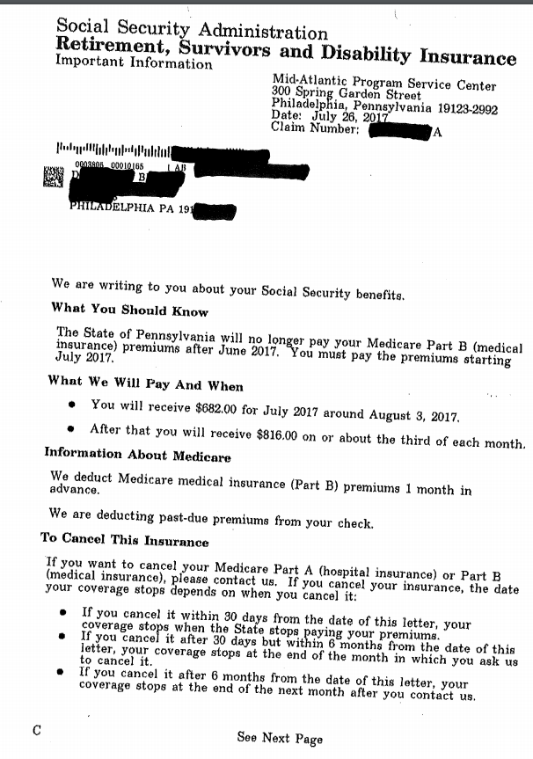
Notice
Although most people find out that Buy-in is off because of SSA letter . . .

Slide 29
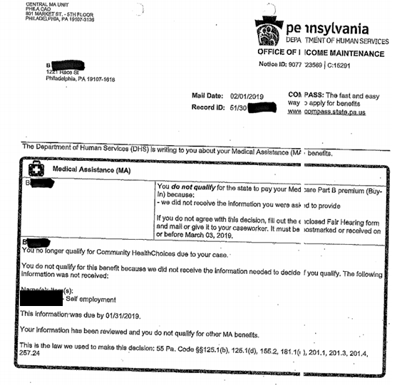
Notice
. . . The real issue is with DHS, which runs the Buy-in program.
DHS is where appeal must be made.

Slide 30
Community Health Choices (not to be confused with Health Choices)

Slide 31
Community Health Choices
Most MA recipients get their MA coverage through Health Choices: the MCOs we discussed earlier
For some people, they get their MA MA benefits through Community Health Choices:
Dual Eligibles – (Medicare and MA) – They show there RWB Medicare card and their Access card for full coverage. Or they have a Medicare Advantage Plan SNP (Special Needs Plan)
Waiver recipients
People who receive Long Term Supports and Services (e.g., nursing home)
Three CHC MCOs:
AmeriHealth Caritas (aka Keystone First CHC in southeast)
UPMC Community HealthChoices
PA Health & Wellness

Slide 32
Who is in CHC?
Anyone with Medicare where the State pays deductible/co-insurance (Healthy Horizon, QMB, MAWD, Waiver). A person who only has SLMB or QI, is not affected because they only have premiums paid for.
Any one on a CHC Waiver
Part A
Part B
Part D
Deductible
Deductible
Medicare Pays
Medicare Pays
Medicare Pays
Co-insurance
Co-insurance
Premiums
Co-Insurance
Co-Pays
Co-Insurance
SSA’s
Low Income Subsidy

Slide 33
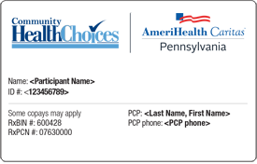
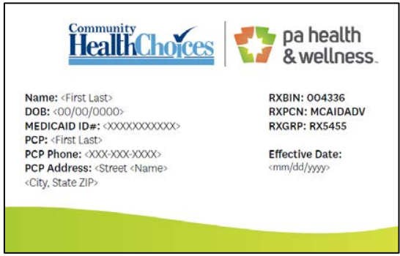
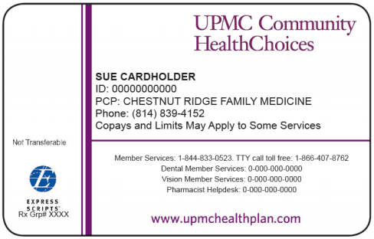
For Dual Eligibles – Medicare Covered Services
Medicare pays first
(usually 80%)

Slide 34
Continued
Almost all doctors take the Red White and Blue Medicare card.
The CHC MCO cannot make you switch your doctors. Even if a provider is not in the CHC MCO network, the CHC MCO must pay the Medical Assistance share of the covered service.
In many cases, it is against the law for a provider to bill a dual eligible patient if they have full MA benefits – even if the provider cannot get the CHC MCO to pay. (If a client gets a bill, they should call the billing office and make sure the provider knows they have both Medicare and Medicaid.

Slide 35
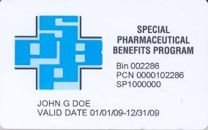
For Dual Eligibles – Prescription Drugs (no change)
Part D Card
(e.g., Silver Scripts, Wellcare, Humana, Aetna)

Slide 36
For Dual Eligibles – Medicaid Covered Services
There are some services that are not covered by Medicare but are covered by Medicaid.
Nonemergency Transportation (to and from MA-covered services)
Dental
Vision
For these use the CHC MCO card – although for transportation use the Medical Assistance Transportation Program provider for your county.
In Philadelphia, that is Modivcare (formerly known as Logisticare)

Slide 37
More Information
DHS has a website with a lot of information:
http://www.healthchoices.pa.gov/info/about/community or just google ‘PA community health choices’

Slide 38
Non-MA Medicare Supplements

Slide 39
Medigap
Medigap (Medicare Supplement Insurance)
Sits on top of Part A and Part B, fills in the “gaps” from the 20% co-insurance. That is, Medigap policies are secondary insurance.
Monthly premiums in addition to Part B premiums
No prescription drug coverage
Cannot be sold to a person with Medical Assistance
Best to enroll within first 6 months after become eligible for Medicare.

Slide 40
Medicare Advantage
Some people opt to have their Part A, B, and D all through one company. This is a Medicare Advantage plan.
Each CHC MCO is required to have a free Medicare Advantage offering – if a client chooses the Medicare Advantage plan of their CHC MCO, they will present their MedAdv card for all services and medications.
Clients are not required to have a Medicare Advantage plan. The CHC MCO will likely market heavily to people in their CHC MCO

Slide 41
For People receiving LTSS services or Waiver Services
The biggest change is that the service coordinators will no longer be a billable service but rather an administrative function of the CHC MCO.
The CHC MCO will either be the service coordinator or subcontract to provide this service.
Providers of services in the “person centered services plan” will need contracts with the CHC MCO to get paid. They will no longer directly bill the state, but rather providers will bill the CHC MCO.

Slide 42
Recap
MA Only – Receive Medical Assistance through an MCO (Managed Care Organization). Use the MCO card for coverage. Not eligible for SPBP.
Medicare Only – Use Red, White and Blue card (or Medicare Advantage company card). Also, Part D card. Eligible for SPBP.
Medicare + Medicaid: Use RW&B card, Community Health Choices Card, Part D card. Automatically enrolled in Extra Help with Part D. Eligible for SPBP but likely issue.

